Slide 1
Project A
Clark Thurston

Slide 2
Executive Summary
Our client needed an upgrade to its IT infrastructure, but they are unable to house or purchase any new equipment. Therefore, I have deployed a single wall DMZ VM network to meet the needs of our client. There are three network segments in this network: the Untrusted Segment which is the internet simulated by a Kali machine, the Trusted Segment which contains a Kali machine and the CEO PC, and the DMZ which contains the DNS Server, the Web Server, and a Kali machine.

Slide 3
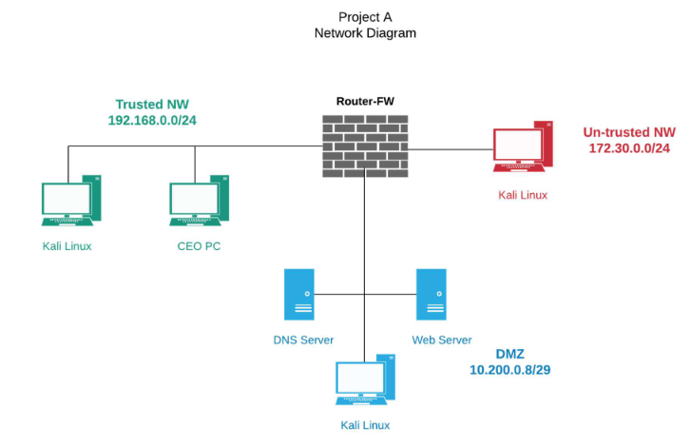
Description of What I Created
There are three appliances that I imported which came preconfigured. The Router, the DNS Server, and the Web Server. I did not tamper with the Router or the DNS Server, but I added an account onto the Web Server.
I added one Kali machine to each network segment.

Slide 4
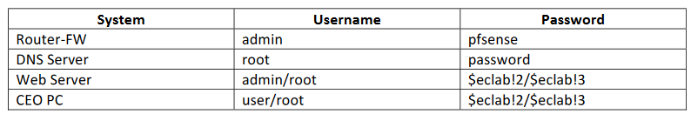
Problems Identified: Login Trouble
I did not understand the “/” naming convention in the passwords. This took almost a whole week to figure out.

Slide 5
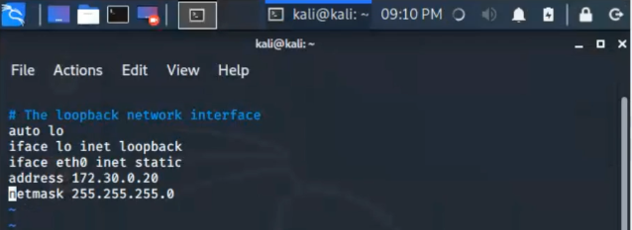
Static IP addressing on the Kali Machines
I correctly surmised that the Kali Machines on the Untrusted and DMZ would not be given an automatic address from the DHCP router. However, I tried to configure the network configuration file in Linux to get this done.
I managed to get this done on two of the machines, but I couldn’t get the DMZ Kali box to work. I deleted all three of them and reimported them to configure by the GUI.

Slide 6
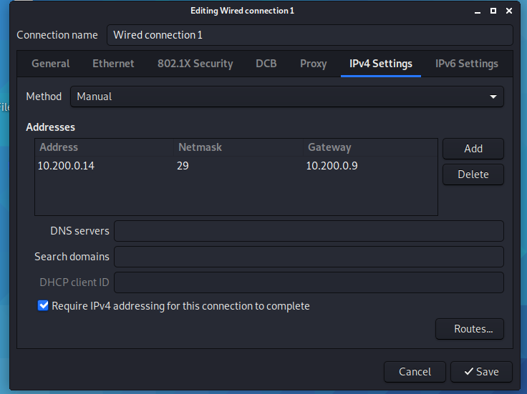
GUI IP addressing for the Kali Machines
I went to the advanced configuration settings and selected the only ethernet cable from the ethernet tab. I went to the IPv4 tab and configured it as follows. This correctly attached all the Kali machines into their respective network segments.

Slide 7
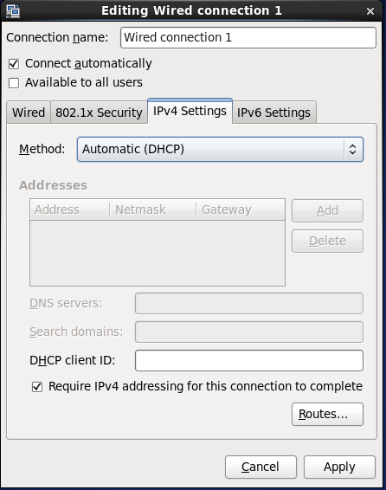
CEO PC Addressing Problems
The CEO PC was connected to the Untrusted network segment by default! I went into the network settings and created a new wired connection. Given that this was supposed to be on the trusted side of the network, I automatically configured it with DHCP.

Slide 8
FTP Functionality
At first, I thought that I had to enter the Web Server’s IP address into the Firefox browser bar. After that failed, I tried to do it via the terminal. I used the command FTP and the Web Server’s IP address. The username and password prompts came up. I had to set the default directory to download the policy, and after that I was able to download the file.
I downloaded the Client List for the Wireshark capture.

Slide 9
Working in the Linux Command Line in General
I found working in Linux very challenging and rewarding. My wife asked me if the project was hard. I told her that “It’s not hard. I know what to do, but I don’t know how to do it”. After I hooked up all the Kali machines via the GUI, I had to look up many of the commands via Google.
I have bought an eBook about Linux from the founder of Linux Academy, and I have joined my hometown’s Linux group on Meetup.

Slide 10
Recommendations and Closing Remarks
This project has taught me the importance of being more open to the idea of using outside help. I was stuck on step 3 for almost the entire two weeks, and I completed the whole project in about one day.
I also learned how rewarding learning could be once things “clicked”.

Slide 11
Sources Consulted
Configure Node Networking—SwiftStack Documentation. (n.d.). Retrieved July 25, 2020, from https://www.swiftstack.com/docs/install/configure_networking.html
Congleton, N. (2018, September 27). Introduction to Nmap on Kali Linux—LinuxConfig.org. https://linuxconfig.org/introduction-to-nmap-on-kali-linux
Gite, V. (2018, January 7). How to check os version in Linux command line. NixCraft. https://www.cyberciti.biz/faq/how-to-check-os-version-in-linux-command-line/
How to use the Linux ftp command to up- and download files on the shell. (n.d.). HowtoForge. Retrieved July 25, 2020, from https://www.howtoforge.com/tutorial/how-to-use-ftp-on-the-linux-shell/
Okoi, M. D. (2019, June 28). How to Find My DNS Server IP Address in Linux. https://www.tecmint.com/find-my-dns-server-ip-address-in-linux/
Schneider, D. (2005, June 29). SolutionBase: Strengthen network defenses by using a DMZ. TechRepublic. https://www.techrepublic.com/article/solutionbase-strengthen-network-defenses-by-using-a-dmz/
Security Baselines. (2019, August 7). https://www.more.net/news/1908073

